Slide 1
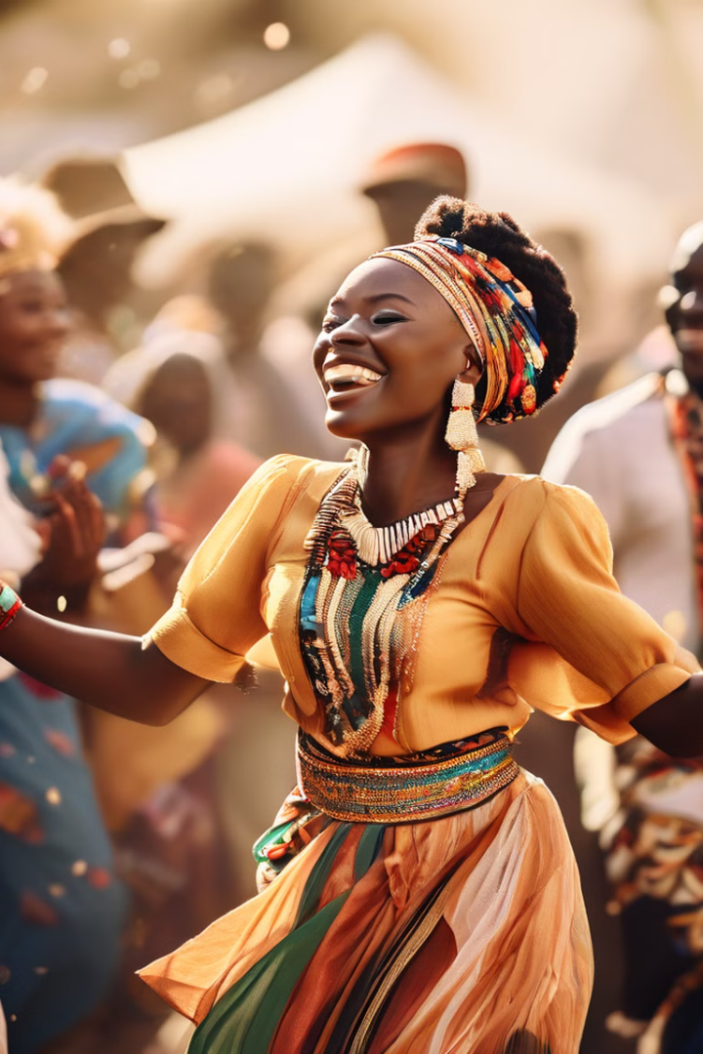

Exploring African Festivals and the Significance of Gender Awareness in Cultural Practices
African culture is rich in traditions, languages, and practices that shape the lives of its people. A major aspect of this culture is the presence of vibrant festivals, which serve as crucial platforms for expressing community values, heritage, and social cohesion. These celebrations go beyond mere entertainment, playing a vital role in reinforcing cultural identity and fostering unity across diverse groups.

Slide 2
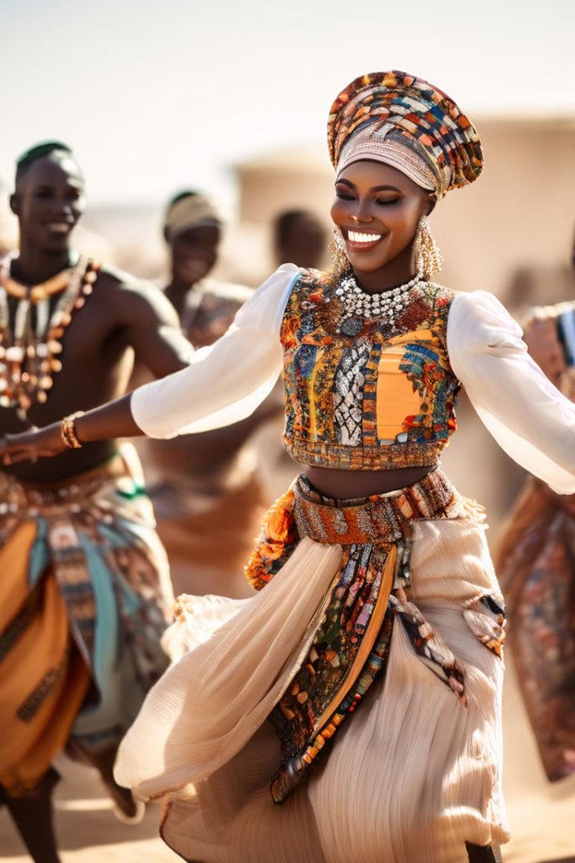
Preserving African Cultural Heritage Through Festivals
1
Oral Histories and Cultural Transmission
Festivals preserve traditions and pass them down through generations.
2
Remembrance and Ancestor Reverence
Festivals honor ancestors, strengthening the connection between the living and the departed.
3
Social Cohesion and Community Bonding
Festivals provide a platform for communities to come together and celebrate their shared identity.
4
Cultural Expressions and Artistic Traditions
Festivals showcase the rich artistic traditions of African cultures, including rituals, music, dance, and storytelling.

Slide 3
Exploring the Diverse Landscape of African Festivals
Maasai Cultural Festival
Mombasa Carnival
Homowo
The Maasai Cultural Festival celebrates the Maasai people's heritage with traditional dances, music, and rituals that honor their age-old customs and lifestyle.
The Mombasa Carnival showcases the rich cultural diversity of the coastal region with a parade of floats, traditional dancers, and musicians. It's a vibrant celebration that brings together various ethnic groups, promoting unity and cultural exchange.
Homowo is an annual festival celebrated by the Ga people of Ghana. It is a harvest festival that commemorates the overcoming of famine in the past.

Slide 4
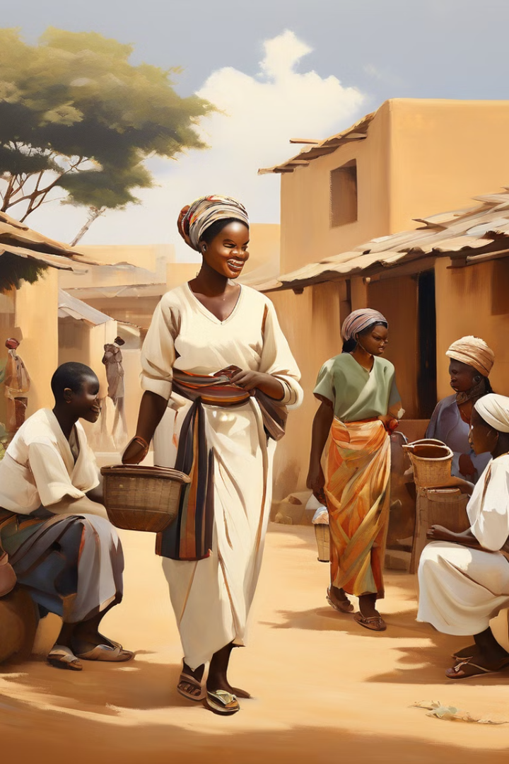
Gender Awareness
1
Historical Influences
Gender roles shaped by history, economics, and social norms.
2
Traditional Expectations
Men as breadwinners, women managing the home.
3
Evolving Perspectives
Increasing recognition of gender equality for empowerment.

Slide 5
The Importance of Gender Awareness in African Society
Equal Opportunities and Participation
Challenging Gender Norms
Empowerment and Social Justice
Gender awareness promotes a society where both men and women have equal access to opportunities, resources, and decision-making power. This leads to greater social inclusion and economic development.
Gender awareness encourages critical reflection on traditional gender roles and norms. It fosters a dialogue on how these norms can be challenged and reformed for a more equitable society.
Gender awareness is essential for promoting women's rights, economic opportunities, and representation in leadership positions. It contributes to social justice and fosters a more balanced and equitable society.

Slide 6




Gender Awareness in African Development
Individual Well-being
Community Resilience
Social Progress
Gender awareness empowers women and men to reach their full potential.
Gender equality helps communities thrive and overcome challenges.
Gender awareness contributes to economic growth and societal development.

Slide 7
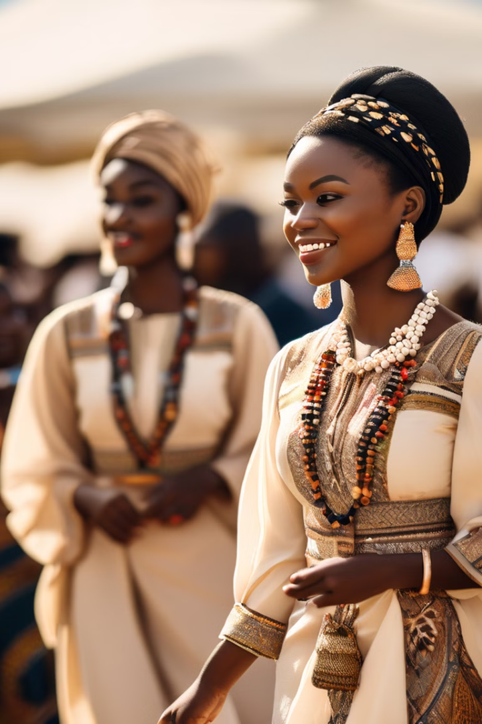
African Festivals
Kenyan festivals like the Maasai Cultural Festival celebrate unique cultural heritage through rituals, music, and dance. The Mombasa Carnival showcases coastal diversity, while the Lamu Cultural Festival honors Swahili culture. Ghana's Homowo festival commemorates overcoming famine.

Slide 8
Challenges and Opportunities for Gender Awareness in African Festivals
1
Traditional Beliefs and Practices
2
Community Engagement and Dialogue
Approach change with sensitivity and respect for cultural values.
Engage with community members and address concerns.
3
Education and Awareness Raising
4
Leadership and Advocacy
Promote gender awareness through workshops and educational programs.
Champion gender equality and promote positive change.

Slide 9
The Future of Gender Awareness in African Festivals
As African societies continue to evolve, the integration of gender awareness into cultural practices will become increasingly important. This is an ongoing process that requires sustained effort and commitment from individuals, communities, and institutions. By embracing gender equality, African festivals can become even more vibrant and inclusive celebrations of cultural heritage.

Slide 10
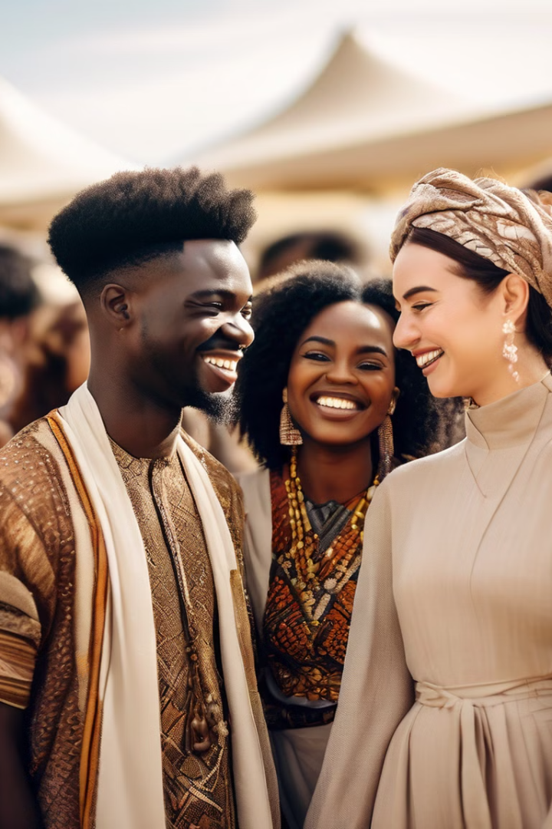
Conclusion: Towards a More Equitable and Inclusive Africa
African festivals are a testament to the rich cultural heritage of the continent. They offer a unique opportunity to foster community bonding, preserve traditions, and promote social cohesion. As African societies evolve, integrating gender awareness into cultural practices is crucial for creating a more equitable and inclusive future. By challenging traditional gender norms and promoting equal opportunities for all, Africa can unleash its full potential and build a society that celebrates both its cultural heritage and the empowerment of all its citizens.

